Slide 1


BATCH-7 BUSINESS LOGISTICS MANAGEMENT FOR CAMPESINOS USING BLOCKCHAIN
DEPARTMENT OF COMPUTER SCIENCE AND ENGINEERING
TEAM MEMBERS:
SHARON SONA.D(211419104249)
SOWMIYA.R(211419104262)
SREELIKITHAA.P(211419104264)
GUIDED BY:
MRS.V.SATHIYA PERIYA ME(PhD)
COORDINATOR:
Dr. K. VALARMATHI ME,PhD
11-04-2023

Slide 2
INTRODUCTION
The vocation of smallholder ranchers in arising economies' cocoa production network is unacceptable as a result of misrepresentation, double-dealing, debasement, duplicity, kid work, and monetary rejection, typically executed by persuasive entertainers.
Blockchain can settle the failures, intricacies, and other social issues of smallholder ranchers in the production network. Production network is an organization of provider, assembling, dissemination, and coordinated factors offices.
There is no stockroom upkeep, direct conveyance to them. This sort of execution decrease the vulnerability along chain, limit delays, wipe out rush exercises, offer great types of assistance.

Slide 3
OBJECTIVE OF THE PROJECT
In the past, the choice of technologies and their adoption was to increase production, productivity and farm incomes.
Over many decades, policies for agriculture, trade, research and development, education, training and advice have been strong influences on the choice of technology, the level of agricultural production and farm practices.
Farmers have always looked to new technologies as a way to reduce costs.
In addition, higher incomes, greater knowledge and improved channels of communication are leading consumers to demand low-cost food of higher quality increasingly produced through organic methods in many countries , with more variety, consistency and year-round availability.

Slide 4
LITERATURE SURVEY
YEAR & AUTHOR | TITLE | DESCRIPTION | MERITS | DEMERITS
1 November 2022 F. Dal Mas , Massaro, M., Ndou V. Raguseo, E. | Blockchain technologies for sustainability in the agrifood sector: A literature review of academic research and business perspectives. | In the realm of digital transformation, Blockchain technologies are considered prominent for managing agrifood supply chains due to their contribution to traceability, safety, quality, transparency, and scalability. | The data stored is encrypted by SHA-256 algorithm. | No security for payments are provided.
10 June 2021 Matthew Quayson,Chunguang Bai, Joseph Sarkis | Technology for Social Good Foundations: A Perspective From the Smallholder Farmer in Sustainable Supply Chains | The livelihood of smallholder farmers in emerging economies' cocoa supply chain is substandard because of fraud, exploitation, corruption, deceit, child labor, and financial exclusion, usually perpetrated by influential actors. | Blockchain implementation for data stored. | No security for payments.

Slide 5
YEAR & AUTHOR | TITLE | DESCRIPTION | MERITS | DEMERITS
03 July 2020 Matthew Quayson; Chunguang Bai; Vivian Osei | Digital Inclusion for Resilient Post-COVID-19 Supply Chains: Smallholder Farmer Perspectives | The coronavirus (COVID-19) pandemic has and continues to have far-reaching global economic and environmental implications. In developing economies and regions, the pandemic's disruption of the agriculture commodity supply chain has made it difficult for smallholder farmers to exist. Smallholder farmer's traditional struggles have worsened. | Digital payments are enabled. | No security for fully digital payments
30 September 2020 P. W. Bergholz, M. Wiedmann. | Toward agent-based models for pre-harvest food safety | The safety of fresh produce is a concern because many types of produce are consumed raw, and the incidence of produce-borne diseases appears to be increasing. Good agricultural practices (GAPs) can limit the chances for contamination of produce, but farms are open systems where interactions with surrounding lands can override benefits from GAPs. | Food contamination is reduced by remote-sensing technologies and ecological modeling | The stockroom facility and unsecured data.

Slide 6
YEAR & AUTHOR | TITLE | DESCRIPTION | MERITS | DEMERITS
10 May 2020 Zhang Bai, Zhang Xuelin, Ma Chaoqun. | Analysis on agro-ecological landscape pattern in Phaeozem land area in Northeast China | The spatial structure of landscape is the result of complicated interaction among nature conditions, living organisms and human activities, which changes reflect the interrelationship among them. With remote sensing (RS) images in the same season of different years, we can get the generalized and visualized information of landscape and its changes. | Accurate results by image processing | The data is not encrypted and hence not secure

Slide 7
PROBLEM STATEMENT
Due to misrepresentation, double-dealing, debasement, dishonesty, kid work, and financial rejection—often carried out by persuasive entertainers—the livelihood of smallholder ranchers in the cocoa production network of developing nations is intolerable.
Due to the above mentioned problem there is need to develop a web app for smallholder ranchers in cocoa production that resolves those problems.
The proposed web application must solve all the problems like misrepresentation , financial rejection , etc., and provide more security features and accurate search results to the customers and secure payments for users off the web application.

Slide 8
EXISTING SYSTEM
To resolve this issue, present an effective TBM calculation to perform coordinating Inside a sliding window. We likewise propose a DRL-based optimization to additional improve the arrangement quality . Broad exploratory outcomes affirm the viability and proficiency of our proposed calculations.
Techniques: Demerits:
SMA Algorithm , SMA is slower to respond to TBM technology cost changes . Not any sort of warning.

Slide 9
PROPOSED SYSTEM
Cryptographic techniques coordinate hypertext, which integrates applying a structure called a calculation to plain text to transform it into something that will transmit an impression of being babble to any individual who doesn’t have the strategy for deciphering it. Then, the provider needs to pay and the subtleties of piece receipt can ready to see by the provider and the director.
Techniques: Merits:
SQL opérations , Changes and the information
AES Algorithm techniques. will be switched over completely to encode text by utilizing cryptography. With the assistance of SQL inquiries can get warning from recipient.

Slide 10
ALGORITHM :
Introduction:
SHA256 stands for Secure Hash Algorithm 256-bit and it's used for cryptographic security. Cryptographic hash algorithms produce irreversible and unique hashes. ... That makes guessing the data hidden within the hash virtually impossible. Hashes cannot be reversed, so the process is typically used for computer security.
Advantages:
SHA is the acronym for Secure Hash Algorithm, used for hashing data and certificate files. Every piece of data produces a unique hash that is thoroughly non-duplicable by any other piece of data. The resulting digital signature is unique too as it depends on the hash that's generated out of the data.
A good hash algorithm makes it impossible to reverse the hash value to compute the original text. However, passwords are very, very short. By making a guess at a password, the attacker can compare the output of his SHA-256 against the SHA-256 that he finds in the database.
Dis-Advantages:
In satisfying the requirements of cryptographic hash, it's a one-way function that is deterministic, fast to compute, resistant to pre-image and second-preimage attacks, and is collision resistant.

Slide 11
HARDWARE REQUIREMENTS
The hardware requirements may serve as the basis for a contract for the implementation of the system and should therefore be a complete and consistent specification of the whole system. They are used by software engineers as the starting point for the system design. It shows what the system does and not how it should be implemented.
PROCESSOR : DUAL CORE 2 DUOS
RAM : 2 GB DD RAM
HARD DISK : 250 GB

Slide 12
SOFTWARE REQUIREMENTS
The software requirements document is the specification of the system. It should include both a definition and a specification of requirements. It is a set of what the system should do rather than how it should do it. The software requirements provide a basis for creating the software requirements specification. It is useful in estimating cost, planning team activities, performing tasks and tracking the teams and tracking the team’s progress throughout the development activity.
FRONT END : J2EE (JSP, SERVLET)
BACK END : MY SQL 5.5
OPERATING SYSTEM : WINDOWS 7
IDE : ECLIPSE

Slide 13
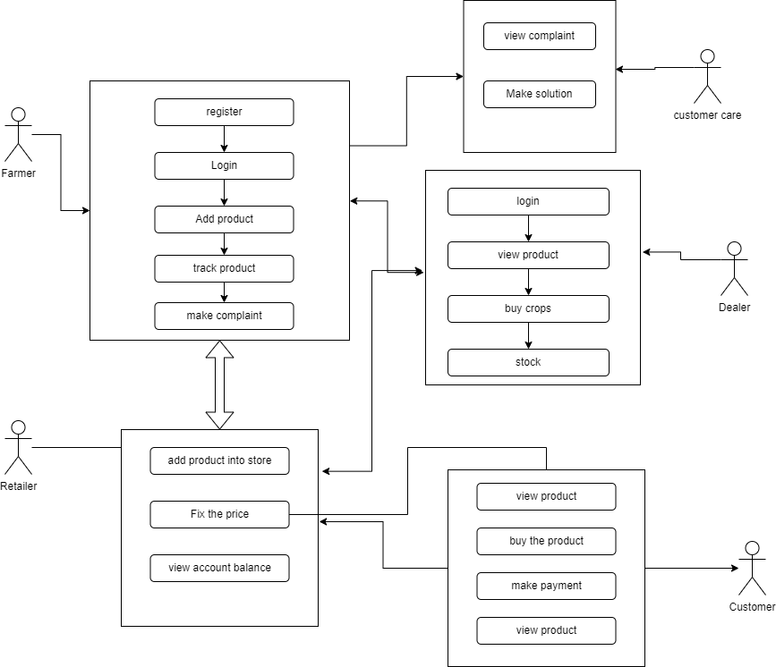
SYSTEM ARCHITECTURE

Slide 14
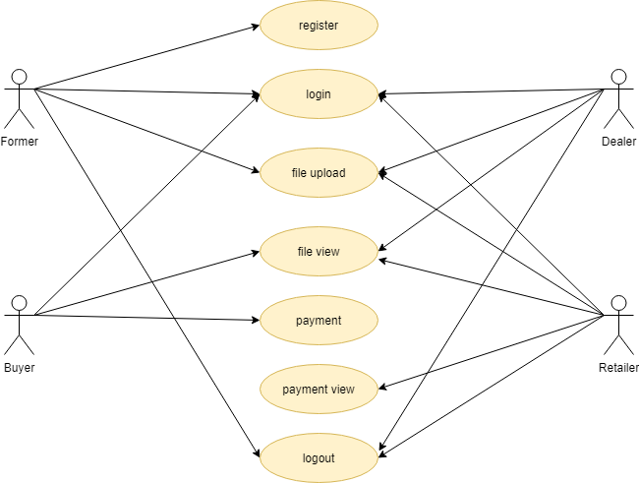
USE-CASE DIGRAM:

Slide 15
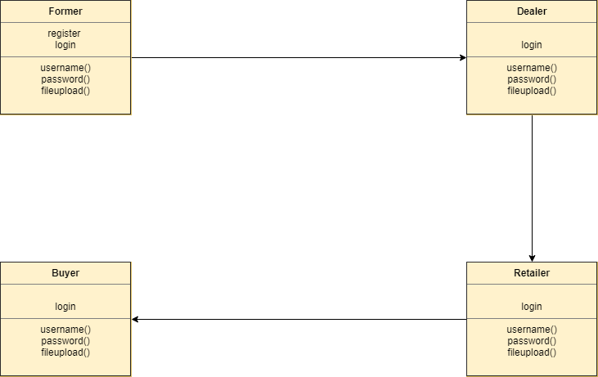
CLASS DIGRAM

Slide 16
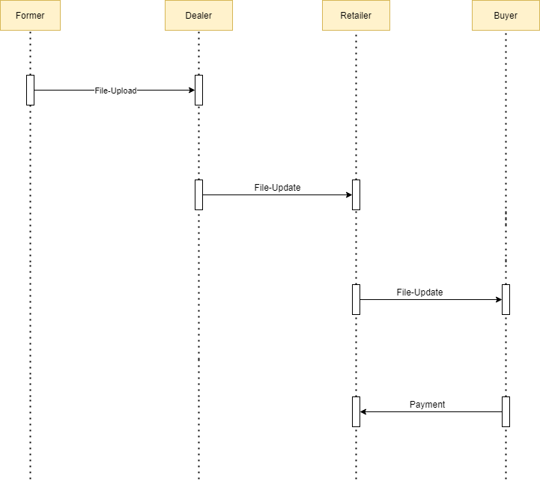
Sequence Diagram
File Update
Payment

Slide 17
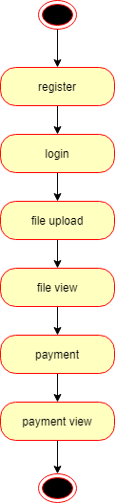
State Diagram:

Slide 18
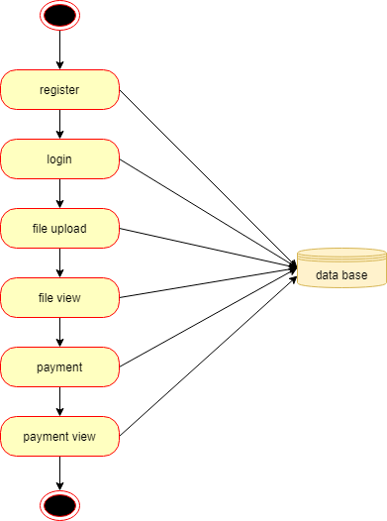
ACTIVITY DIAGRAM:

Slide 19
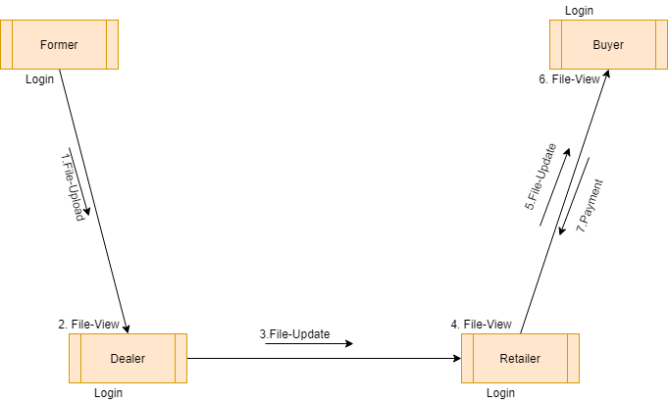
COLLABORATION DIAGRAM
FILE UPDATE
PAYMENT

Slide 20
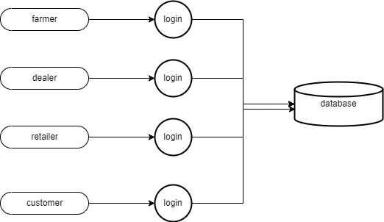
LEVEL 0

Slide 21
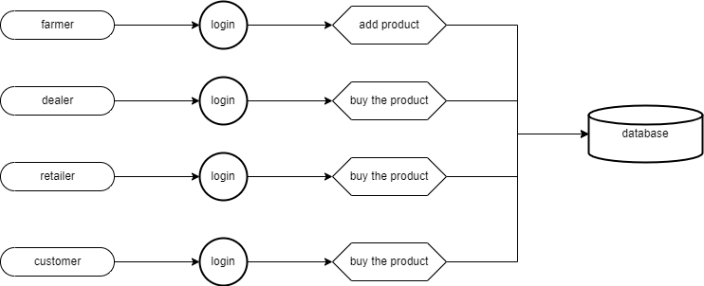
LEVEL 1

Slide 22
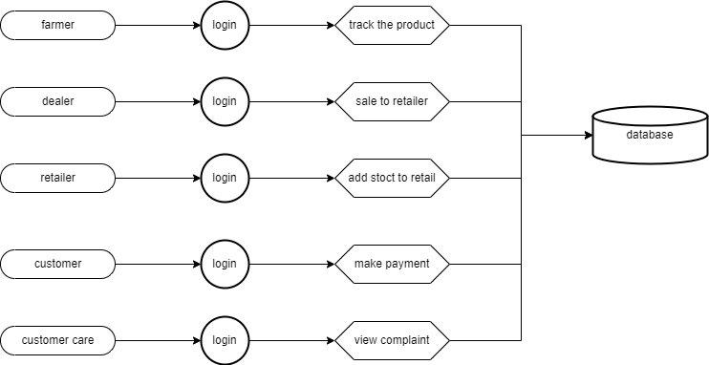
LEVEL 2

Slide 23
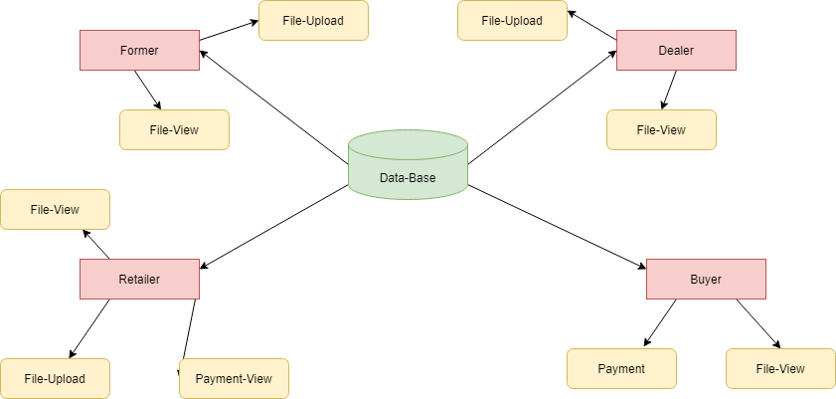
ER-Diagram

Slide 24
MODULES
MODULE NAMES
LOGIN
FARMER FILE-UPLOAD
BUYER FILE-VIEW
BUYER PAYMENT
FARMER PAYED-VIEW

Slide 25
MODULE DESCRIPTION :
1.LOGIN :
This is the first module in our project, here symbolizes a unit of work performed within a database management system (or similar system) against a database, and treated in a coherent and reliable way independent of other transactions. A transaction generally represents any change in database user will transfer the amount to provider.
2. FARMER FILE-UPLOAD:
In this module is used to help to the farmer to upload the file with the land longitude and the user will update the report along with their opinion and the will be stored the database.

Slide 26
3. BUYER FILE VIEW:
In this module the Buyer will also view the data file. And analys the Buyer will be responsible for your file stored in database.
4. BUYER PAYMENT :
In this module the Buyer will also Payment the data file fully analyzed data in category wise view. Buyer will be responsible for your file stored in database.
5. FARMER PAYMENT VIEW:
In this module the farmer will also view the Payment. And analyse the farmer will be responsible for your file stored in database.

Slide 27
TESTING AND RESULTS
Test case id | Testcase/Action to be performed | Expected Result | Actual Result | Pass/Fail
1. | Selecting “FARMER” button | Open Farmer Login | Open Farmer Login | Pass
2. | Selecting “DEALER” button | Open Dealer Login | Open Dealer Login | Pass
3. | Selecting “CUSTOMER” button | Open Customer Login | Open Customer Login | Pass
4. | Selecting “CUSTOMER CARE” button | Open Customer care Login | Open Customer care Login | Pass

Slide 28
Test case id | Testcase/Action to be performed | Expected Result | Actual Result | Pass/Fail
5. | Selecting “PRODUCT UPLOAD” button | Open Product Upload form | Open Product Upload form | Pass
6. | Selecting “VIEW” button | Open Product view page | Open Product view page | Pass
7. | Selecting “PRODUCT VIEW” button | Open Upload products page | Open Upload products page | Pass
8. | Selecting “SHOP” button | Open Shop page | Open Shop page | Pass

Slide 29


Slide 30
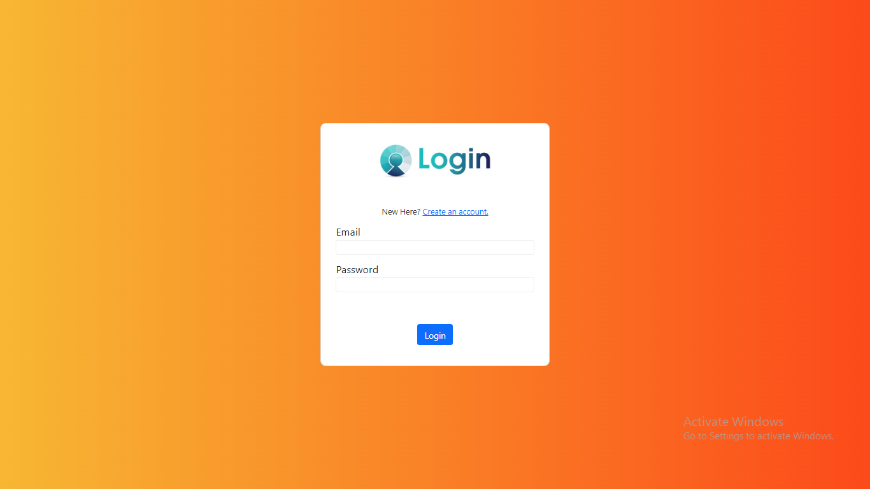

Slide 31
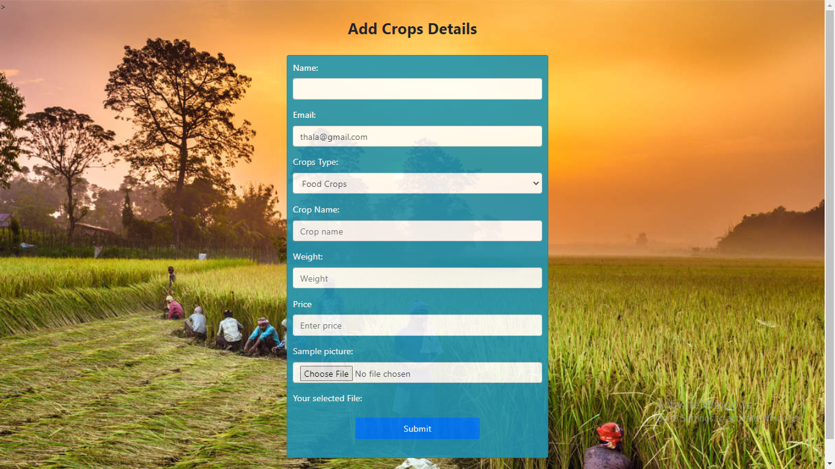

Slide 32
CONCLUSION
We have proposed for real-time provisioning in cloud-based industrial applications.
It aimed at getting an optimized execution cost dynamically with the consideration of user-defined security configuration constraints.
In this process picker hub receive the client parcel and send delivery address everything is monitoring in and finally branch manager send the daily picking parcel and delivery in branch hub every details to send the head office.
The branch manager report will be send secure the head office . Report will be encrypted first using AES algorithm.

Slide 33
FUTURE ENHANCEMENTS
Implementing a real-world database system.
Improving the efficiency of protocols, in terms of number of messages exchanged and in terms of their sizes, as well.
Implement using two are more algorithms .

Slide 34
REFERENCES
[1] B. Amuzu-sefordzi, K. Martinus, P. Tschakert, and R. Wills, “Disruptive innovations and decentralized renewable energy systems in Africa: A socio-technical review,” Energy Res. Social Sci., vol. 46, pp. 140–154,
2018, doi: 10.1016/j.erss.2018.06.014.
[2] C. Bai and J. Sarkis, “Improving green flexibility through advanced manufacturing technology investment: Modeling the decision process,” Int. J. Prod. Econ., vol. 188, pp. 86–104, 2017, doi: 10.1016/j.ijpe.2017.03.013.
[3] C. Bai and J. Sarkis, “A supply chain transparency and sustainability technology appraisal model for blockchain technology,” Int. J. Prod. Res., vol. 58, no. 7, pp. 2142–2162, 2020, doi: 10.1080/00207543.2019.1708989.
[4] C.Bai, B. Shi, F. Liu, and J. Sarkis, “Banking creditworthiness: Evaluating the complex relationships,” Omega, vol. 83, pp. 26–38, 2019.
[5] S. Baurzhan and G. P. Jenkins, “Off-grid solar PV: Is it an affordable or appropriate solution for rural electri fi cation in Sub-Saharan African countries?” Renewable Sustain.EnergyRev., vol. 60, pp. 1405–1418, 2016, doi: 10.1016/j.rser.2016.03.016.

Slide 35
[6] R. Birner and D. Resnick, “The political economy of policies for smallholder agriculture,”World Develop., vol. 38, no. 10, pp. 1442–1452, 2010, doi: 10.1016/j.worlddev.2010.06.001.
[7] C. Andrew, “Modern slavery as a management practice: Exploring the conditions and capabilities for human exploitation,” Acad. Manage. Rev., vol. 38 , no. 1, pp. 45–69, 2013, doi: 10.2307/23416302.
[8] R. Glavee-Geo, U. Burki, and A. Buvik, “Building trustworthy relationships with smallholder (small-scale) agro-commodity suppliers: Insights from the Ghana cocoa industry,” J. Macromarketing, vol. 40, no. 1, pp. 110–127, 2020, doi: 10.1177/0276146719900370.
[9] M. Janssen, V. Weerakkody, E. Ismagilova, U. Sivarajah and Z. Irani, "A framework for analyzing blockchain technology adoption: Integrating institutional market and technical factors", Int. J. Inf. Manage., vol. 50, pp. 302-309, 2020.
[10] A. Kamilaris, A. Fonts and F. X. Prenafeta-Boldύ, "The rise of blockchain technology in agriculture and food supply chains", Trends Food Sci. Technol., vol. 91, pp. 640-652, 2019.

Slide 36
THANK YOU

